Slide 1
A Primer on Inventory Optimization using Excel/Python
Dr. Sunil Chinta

Slide 2
About Myself
Working as an Independent consultant for multiple entities
Over 15+ years of experience in building Retail & Supply Chain systems
Previously worked for Target and JDA Software (now Blue Yonder)
PhD in Operations Research from IIT Madras
Check-out my profile: https://www.linkedin.com/in/sunilchinta/

Slide 3
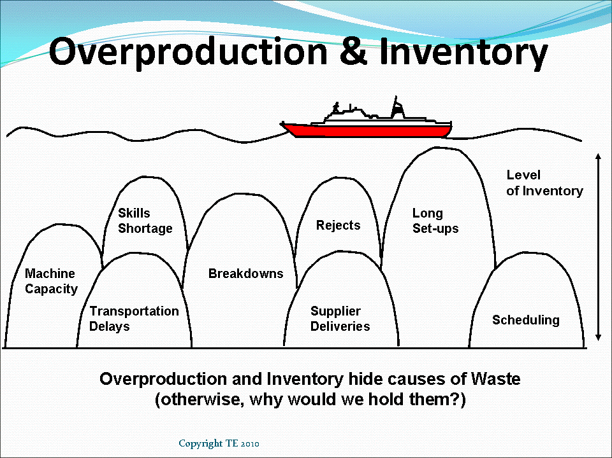
Inventory Optimization
A fundamental problem in Retail is Inventory Optimization
How to move inventory optimally from suppliers to shoppers
The best definition for inventory is "Necessary Evil"
Customer Demand is fairly uncertain
Nirvana is when Inventory appears “just in time” to satisfy Demand
In the world of COVID too ?
This is a Stochastic Control problem
We start with an exposition of three classical simple problems:
Economic Order Quantity (EOQ) problem
Multi-item EOQ under budget constraints
Newsvendor problem
Image Credits: Just in Time JIT Production; Benefits and Requirements (leanmanufacturingtools.org)

Slide 4
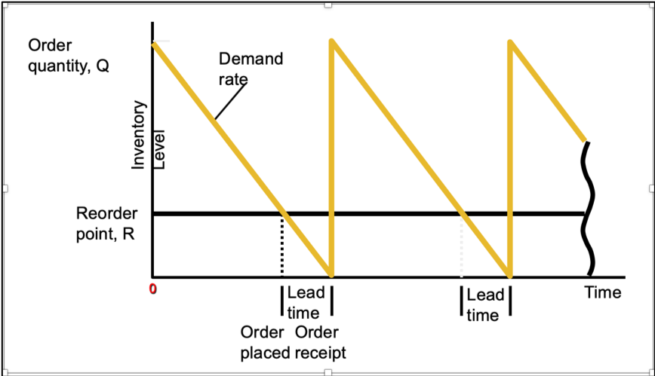
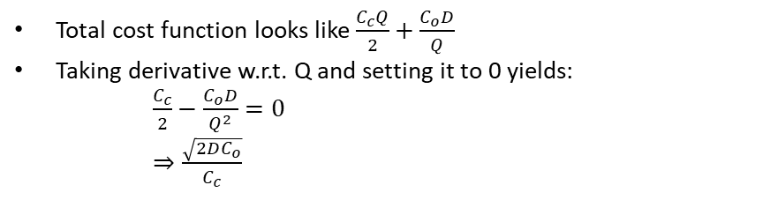
Economic Order Quantity (EOQ)
Re-order point: Inventory level at which an order is placed
Q: Order Quantity (Decision Variable)
Cc : Carrying cost per unit per year
Co: Order cost per order
D: Annual Demand
Total cost function looks like $\frac{C_{c}Q}{2}+\frac{C_{o}D}{Q}$
Taking derivative w.r.t. Q and setting it to 0 yields:
$\frac{C_{c}}{2}−\frac{C_{o}D}{Q^{2}}=0$
$⇒\frac{\sqrt{2DC_{o}}}{C_{c}}$

Slide 5
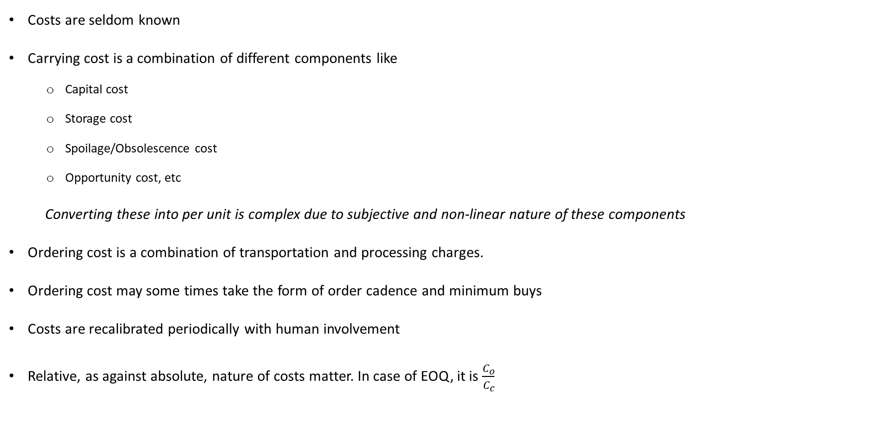
A note on costs
Costs are seldom known
Carrying cost is a combination of different components like
Capital cost
Storage cost
Spoilage/Obsolescence cost
Opportunity cost, etc
Converting these into per unit is complex due to subjective and non-linear nature of these components
Ordering cost is a combination of transportation and processing charges.
Ordering cost may some times take the form of order cadence and minimum buys
Costs are recalibrated periodically with human involvement
Relative, as against absolute, nature of costs matter. In case of EOQ, it is $\frac{C_{o}}{C_{c}}$

Slide 6
Excel Exercise: EOQ
Using simulation or Evaluation compute the EOQ (curves) for the following scenario:
Carrying cost/unit/year: 5
Order cost/order: 100
Annual demand : 50000

Slide 7
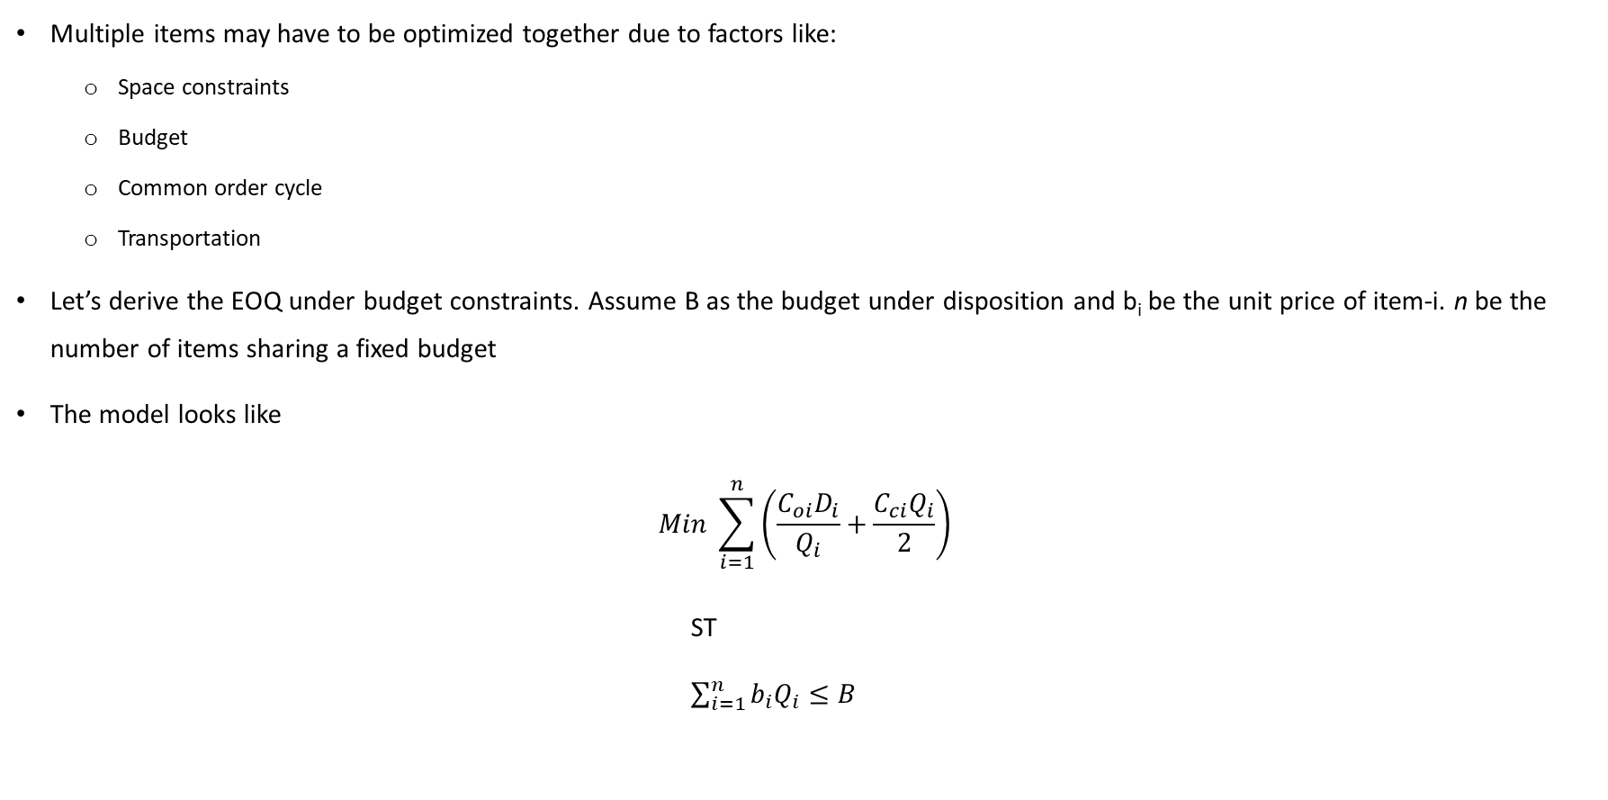
Multi-item EOQ
Multiple items may have to be optimized together due to factors like:
Space constraints
Budget
Common order cycle
Transportation
Let’s derive the EOQ under budget constraints. Assume B as the budget under disposition and b_{i} be the unit price of item-i. n be the number of items sharing a fixed budget
The model looks like
$$Min \sum_{i=1}^{n}{\left(\frac{C_{oi}D_{i}}{Q_{i}}+\frac{C_{ci}Q_{i}}{2}\right)}$$
ST
$\sum_{i=1}^{n}{b_{i}Q_{i}≤B}$

Slide 8
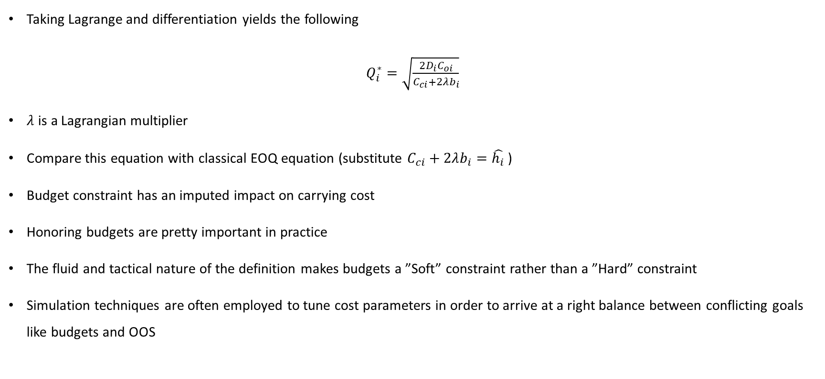
Multi-item EOQ (Contd.)
Taking Lagrange and differentiation yields the following
$Q_{i}^{∗}=\sqrt{\frac{2D_{i}C_{oi}}{C_{ci}+2λb_{i}}}$
$λ$ is a Lagrangian multiplier
Compare this equation with classical EOQ equation (substitute $C_{ci}+2λb_{i}=\hat{h_{i}}$ )
Budget constraint has an imputed impact on carrying cost
Honoring budgets are pretty important in practice
The fluid and tactical nature of the definition makes budgets a ”Soft” constraint rather than a ”Hard” constraint
Simulation techniques are often employed to tune cost parameters in order to arrive at a right balance between conflicting goals like budgets and OOS

Slide 9
Excel Solver: Multi-item EOQ
We have 3 items with the following data
Item | unit cost | carrying cost | order cost | annual demand
A | 5 | 0.6 | 40 | 10000
B | 10 | 1.2 | 90 | 25000
C | 15 | 1.8 | 200 | 35000
What will be their EOQ?
What will be the EOQ if budget on item procurement cost is
75000
50000

Slide 10
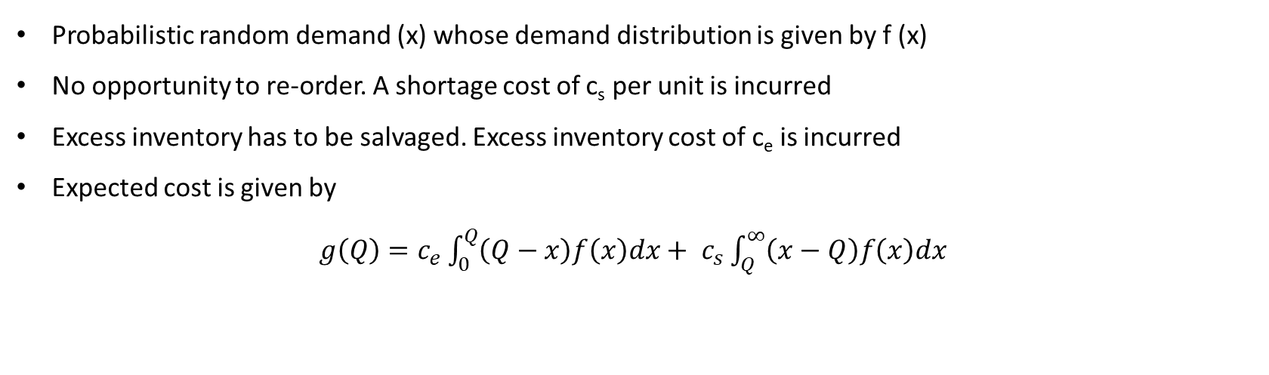
News Vendor Problem
Every day a news vendor has to decide the number of news papers to be bought such that he minimizes the total cost which is the sum of opportunity cost and excess ordering cost
Every season a Buyer has to decide the quantity of fashion apparel to be bought such that he minimizes the total cost which is the sum of opportunity cost and excess ordering cost
Probabilistic random demand (x) whose demand distribution is given by f (x)
No opportunity to re-order. A shortage cost of c_{s} per unit is incurred
Excess inventory has to be salvaged. Excess inventory cost of c_{e} is incurred
Expected cost is given by
$g\left(Q\right)=c_{e}\int_{0}^{Q}{\left(Q−x\right)f\left(x\right)dx+ }$ $c_{s}\int_{Q}^{∞}{\left(x−Q\right)f\left(x\right)dx }$

Slide 11
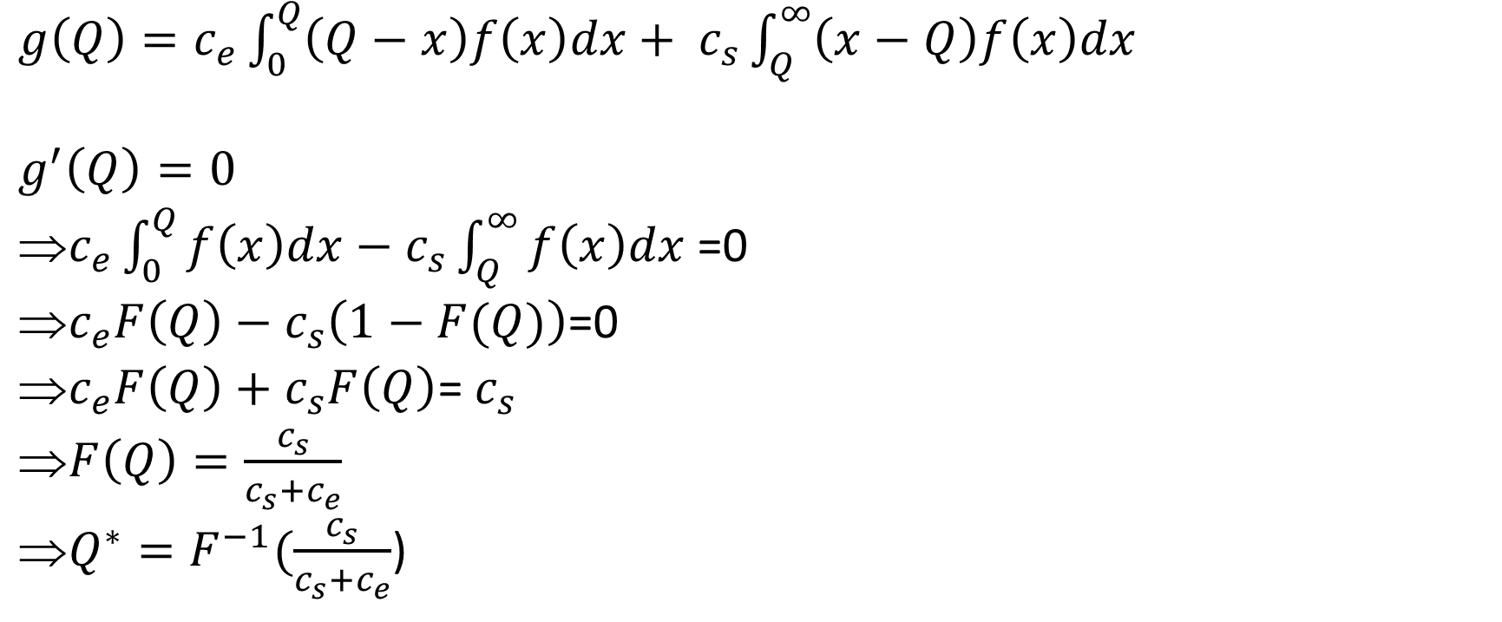
Optimize News Vendor Function
$g\left(Q\right)=c_{e}\int_{0}^{Q}{\left(Q−x\right)f\left(x\right)dx+ }$ $c_{s}\int_{Q}^{∞}{\left(x−Q\right)f\left(x\right)dx }$
$$g^{′}\left(Q\right)=0$$
$c_{e}\int_{0}^{Q}{f\left(x\right)dx−}$ $c_{s}\int_{Q}^{∞}{f\left(x\right)dx }$=0
$c_{e}F\left(Q\right)−$ $c_{s}\left(1−F(Q)\right)$=0
$c_{e}F\left(Q\right)+c_{s}F\left(Q\right)$= $c_{s}$
$F\left(Q\right)=\frac{c_{s}}{c_{s}+c_{e}}$
$Q^{∗}=F^{−1}(\frac{c_{s}}{c_{s}+c_{e}}$)

Slide 12
News Vendor Problem
F(x) is probability of no stockout aka Type-1 service level
Business users understand the concept of service level well and goals are often set in the form of service levels. Costs are imputed from service levels
Business users understand the concept of service level well and goals are often set in the form of service levels. Costs are imputed from service levels

Slide 13
Python Exercise: News Vendor (Poisson)
A seasonal seller sells certain apparel.
From his past experience he knows that demand for the season follows Poisson distribution with mean = 100.
He procures at a cost of $5 and sells it at a markup of 50%
Any unsold items are salvaged at $1
What should be his optimal purchase quantity to maximize profit?
Under stocking cost = ??
2.5
Over stocking cost = ??
5-1 = 4
F(X) = 2.5/(4+2.5) = 0.384

Slide 14
Python Exercise: News Vendor (Empirical distribution)
Let’s assume seller doesn’t know about the exact probability distribution
Also assume the season lasts for 7 days
From his past experience, he knows that the daily sales can look like below:
30% of the times, no sale
20 % of the times, sale of 1 unit
30 % of the times, sale of 2 units
20% of the times, sale of 3 units

Slide 15
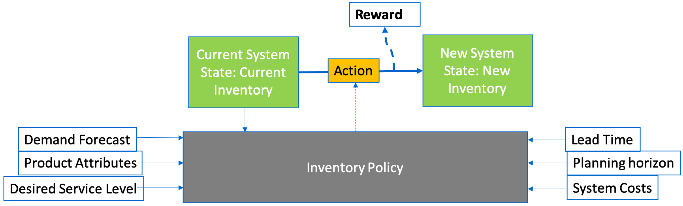
Inventory Ordering Policy
Inventory Policy is a rule or set of rules that govern the actions to be taken for a given state (inventory) of the system
Policy is a function that maps state to an action
When an action is taken based on inventory policy
System goes to a new state (Inventory position)
A reward is generated by the system

Slide 16
Practical Inventory optimization problem
In practice, Inventory flows through a network of DCs/stores
From source (suppliers) to destination (stores or homes)
So, we have to solve a multi-“node” Inventory Optimization problem
State is joint inventory across all nodes (and between nodes)
Action is recommended movements of inventory between nodes
Reward is the aggregate of daily costs across the network
Space and Throughput constraints are multi-item costs/constraints
So, real-world problem is multi-node and multi-item (giant MDP)
S1
Store Ship Pack
Eaches
S2
Vendor Case Pack
S3
Vendor
DC
S4
Customer demand
.
.
.
.
.
.

Slide 17
Service Level
The definition of service level is very significant in inventory control
Two commonly used service levels are
Type-1 service level: Probability of no stockout in an order cycle
P(X<= Q)
Type-2 service level: Fill rate aka demand proportion met
Fill Rate = E( Demand Fulfilled/Demand Requested)
Academic research often assumes type-1 service level in their models due to its mathematical tractability. While in practice, type-2 service level is a more common metric

Slide 18
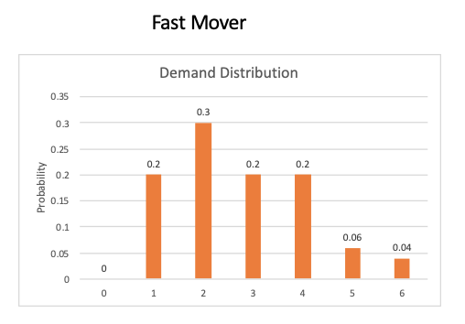
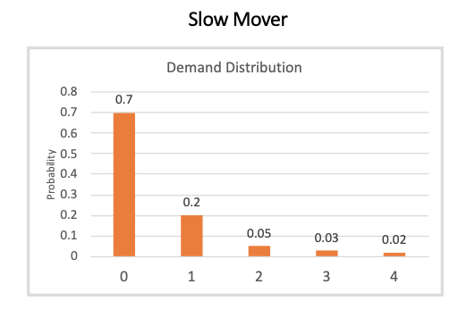
Service levels and Item velocities
Inventory level of 4 achieves a desired type-1 service level of 90% and type-2 service level of 97.4%
type-2 service ≥ type-1 service when P(demand = 0) → 0
Inventory level of 1 achieves a desired type-1 service level of 90% and type-2 service level of 80%
When P(demand = 0) ⋙ 0 i.e. for slow movers type-1 service ≥ type-2

Slide 19
Importance of accurate forecasting
Good Probabilistic forecasting is the key
Use business centric metrics along with statistical error measures
Probabilistic forecasting matters more for stores when compared to distribution centers purely because of law of large numbers
Systematic biases will have multiplying affect as order cycles and lead times increase
Multi-level forecasting and forecast reconciliation always helps
Forecast accuracy is always a challenge. Divide and Conquer
Explainable and robust forecasts always wins

Slide 20
Re-balance network inventory
You received a call from an Inventory analyst that DC B is soon going to be out of stock for a high selling seasonal item. Time is too short for a Vendor replenishment. Network inventory position revealed that DC A is sitting on too much of inventory which will likely be a expensive markdown!
You decided to transfer inventory from DC A to DC B. Transportation ops informed you that nodes A and B are not directly connected and inventory has to be flown through transshipment nodes. As this being a busy season and limited free capacity, the incremental flow between the nodes is limited. You can only transfer once due to time constraint.
You need to determine the maximum you can transfer from DC A to DC B (Formulate an LP)
Origin | Destination | Capacity
A | I₁ | 20
A | I₂ | 15
I₁ | I₃ | 5
I₁ | B | 10
I₂ | I₃ | 5
I₂ | B | 20
I₃ | B | 10
1. What is the source & sink
2. Plot network
3. What is the objective?
4. What are the decision variables?

Slide 21
Mathematical optimization terminology
Decision Variables : These are the elements under the control of the decision-maker, and their values determine the solution of the model
Objective function: Once we formulate the problem in mathematical terms, we have function/ criterion or objective, which we seek to maximize or minimize.
Constraints : The constraints are the restrictions or limitations on the decision variables.
Lower bounds / Non negativity constraints: Explicit constraints on decision variables that need to be specified to bound the feasible region.
Notes:
Constraints usually limit the value of the decision variables.

Slide 22
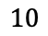
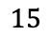
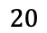
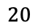
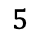
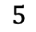
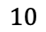
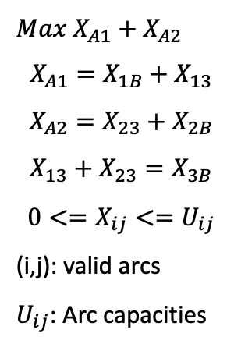
Re-balance network inventory: formulation
Origin | Destination | Capacity
A | I₁ | 20
A | I₂ | 15
I₁ | I₃ | 5
I₁ | B | 10
I₂ | I₃ | 5
I₂ | B | 20
I₃ | B | 10
I₁
$$10$$
$$20$$
$$5$$
A
I₃
$$10$$
B
$$15$$
$$5$$
I₂
$$20$$
Additional Info:
These are Max flow problems
Ford-Fulkerson method is an efficient algo. to solve this problem class
Shortest path & Minimal spanning tree belong to same family
Solving as an LP always yields an integer solution: Uni-modularity: Think of matrix determinant
$Max X_{A1}+$ $X_{A2}$
$$X_{A1}=X_{1B}+X_{13}$$
$$X_{A2}=X_{23}+X_{2B}$$
$$X_{13}+X_{23}=X_{3B}$$
$$0<=X_{ij}<=U_{ij}$$
(i,j): valid arcs
$U_{ij}$: Arc capacities

Slide 23
OR-Tools
Open source software suite for Optimization developed by Google
For Linear programming problems, it has an inbuilt solver called glop (Google's linear programming system)
It can be integrated with commercial or open-source solvers
Solvers
Commercial:
CPLEX: The best!
Gurobi: Target uses it
FICO, LINDO, LINGO… (Mid tier)
Open Source (use with caution!):
OR-Tools
COIN-OR (family of solvers)
Installation:
python -m pip install --upgrade --user ortools

Slide 24
OR-Tools: Basic Syntax
ortools.linear_solver. pywraplp : Python wrapper for or-tools lp
pywraplp.Solver: Solver to be used
NumVar(), BoolVar(), IntVar(): Continuous/Bool/Int variables
Objective(): Objective function specification
Constraint(), Add(): Addition of constraints
Solve(): Optimizes the model
Sum(): Summation expression over variables/constants

Slide 25
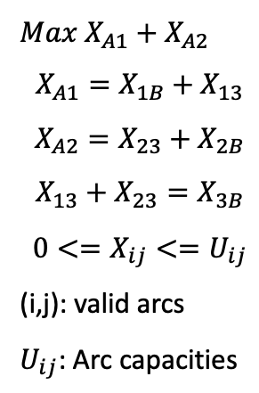
Network Rebalancing (revisited)
I₁
$$10$$
$$20$$
$$5$$
A
I₃
$$10$$
B
$$15$$
$$5$$
I₂
$$20$$
$Max X_{A1}+$ $X_{A2}$
$$X_{A1}=X_{1B}+X_{13}$$
$$X_{A2}=X_{23}+X_{2B}$$
$$X_{13}+X_{23}=X_{3B}$$
$$0<=X_{ij}<=U_{ij}$$
(i,j): valid arcs
$U_{ij}$: Arc capacities
1. Write Python code to solve this specific formulation
2. Programmatically prove that linear and integer programming yields same solution

Slide 26
Learnings from my personal experience
Master the art & science of problem decomposition
Slightly inaccurate but robust models are better than accurate and non-robust models
Prefer Glass-Box models over Black-Box models
The cycle of Hypothesis -> Data -> Intuition ->Hypothesis for data driven decision making
Know your user and gain his confidence. Often it may be (wo)man and machine rather than (wo)man vs machine
There is always a trade-off between exact solution of an approximate model approximate solution of an exact model

Slide 27
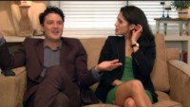
This is what happens in reality
https://youtu.be/seO2yX-lN3M
Credits: O9 solutions

Slide 28
Course slides & codes can be accessed here
chintasunny/symbiosis_2023: Guest lecture at Symbiosis (github.com)

Slide 29
Acknowledgements
I would like to sincerely thank Prof. Sri Yogi and Symbiosis institute for giving me this opportunity to interact with you all

